Slide 1

Home Décor Store wireframes
TEAM 3 · SOFTWARE DEVELOPMENT LIFE CYCLE
Eight screens for Increments 1 and 2, aligned with the live site on 10 November 2026
Notes:
These slides are taken from the wireframe canvas as it stands today. Each screen slide repeats the numbered notes beside that screen on the canvas, so the numbers match the orange markers in the pictures.

Slide 2
Eight screens across two increments
OVERVIEW
Screen | Name | What it shows | Inc | Live today
W-01 | Home | Hero, categories, rooms, product cards | 2 | Hero and cards
W-02 | Search and category results | Filters, count, sort, cards | 2 | Not built
W-03 | No results | Message and ways out | 2 | Not built
W-04 | Product page | Size, colour, stock, Add to cart | 2 | Not built
W-05 | Product page, phone | The same in one column | 2 | Not built
W-06 | Cart | Lines, totals, delivery | 2 | Not built
W-07 | Admin sign-in | Errors and lockout | 1 | Sign-in works
W-08 | Admin area: add product | Details, placement, options, stock | 1 | Live, no session banner
Notes:
Increment 1 is the admin side and is largely built. Increment 2 is the storefront: only the home page hero and the product cards exist on the live site today; the rest is built in weeks 4 and 5.

Slide 3
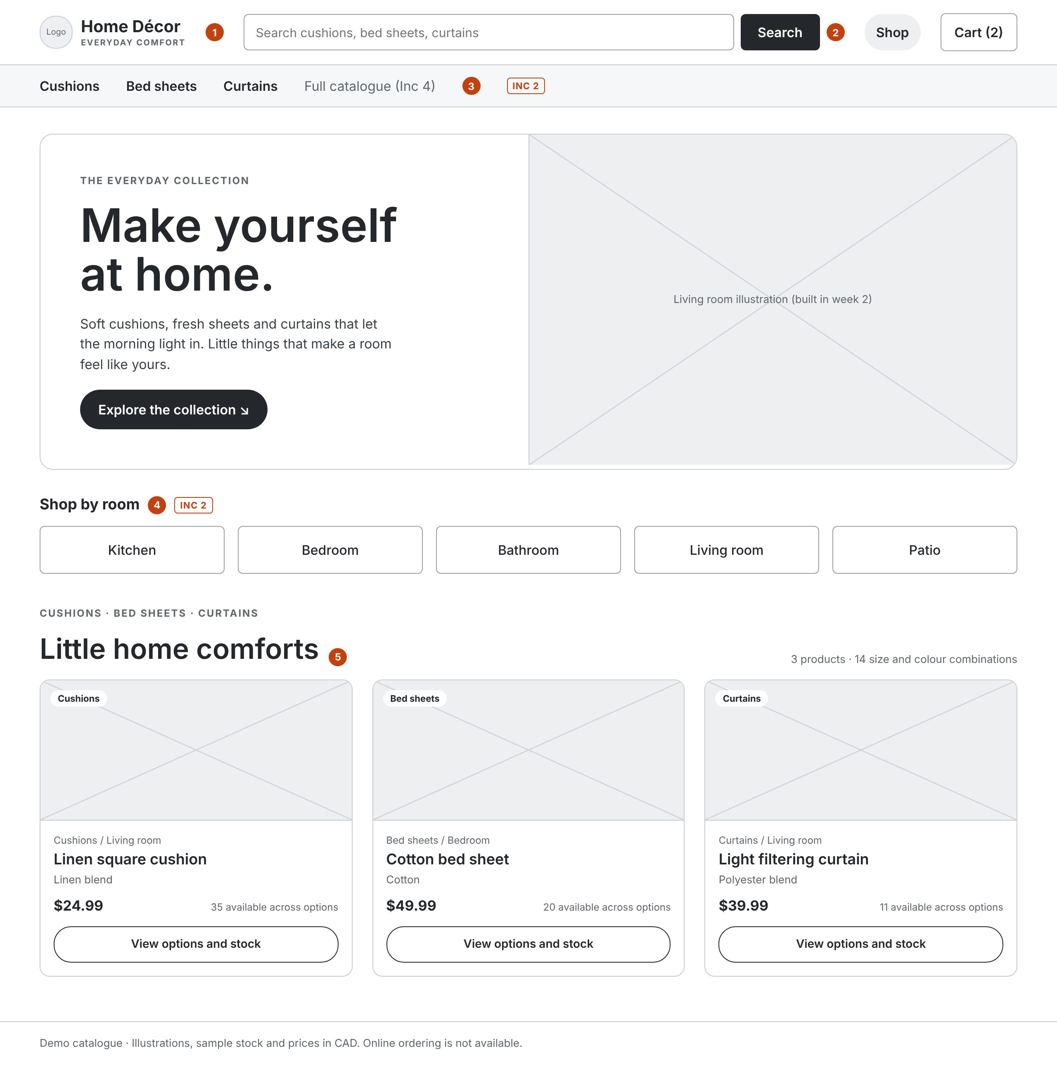
W-01 Home
INCREMENT 2 · STOREFRONT
Matches the live home page. Increment 2 adds search, a category bar and shop by room.
1 Home Décor header. The live site’s Admin link must go for shoppers (OBS-07).
2 Search by name, description and material (D3).
3 Category bar: Cushions, Bed sheets, Curtains.
4 Shop by room: Kitchen, Bedroom, Bathroom, Living room, Patio.
5 The live product cards. Any product is within three clicks.
Notes:
The hero copy and the three products are taken from the live site: Linen square cushion $24.99, Cotton bed sheet $49.99, Light filtering curtain $39.99, all in CAD. Items tagged INC 2 on the screen are not built yet.

Slide 4
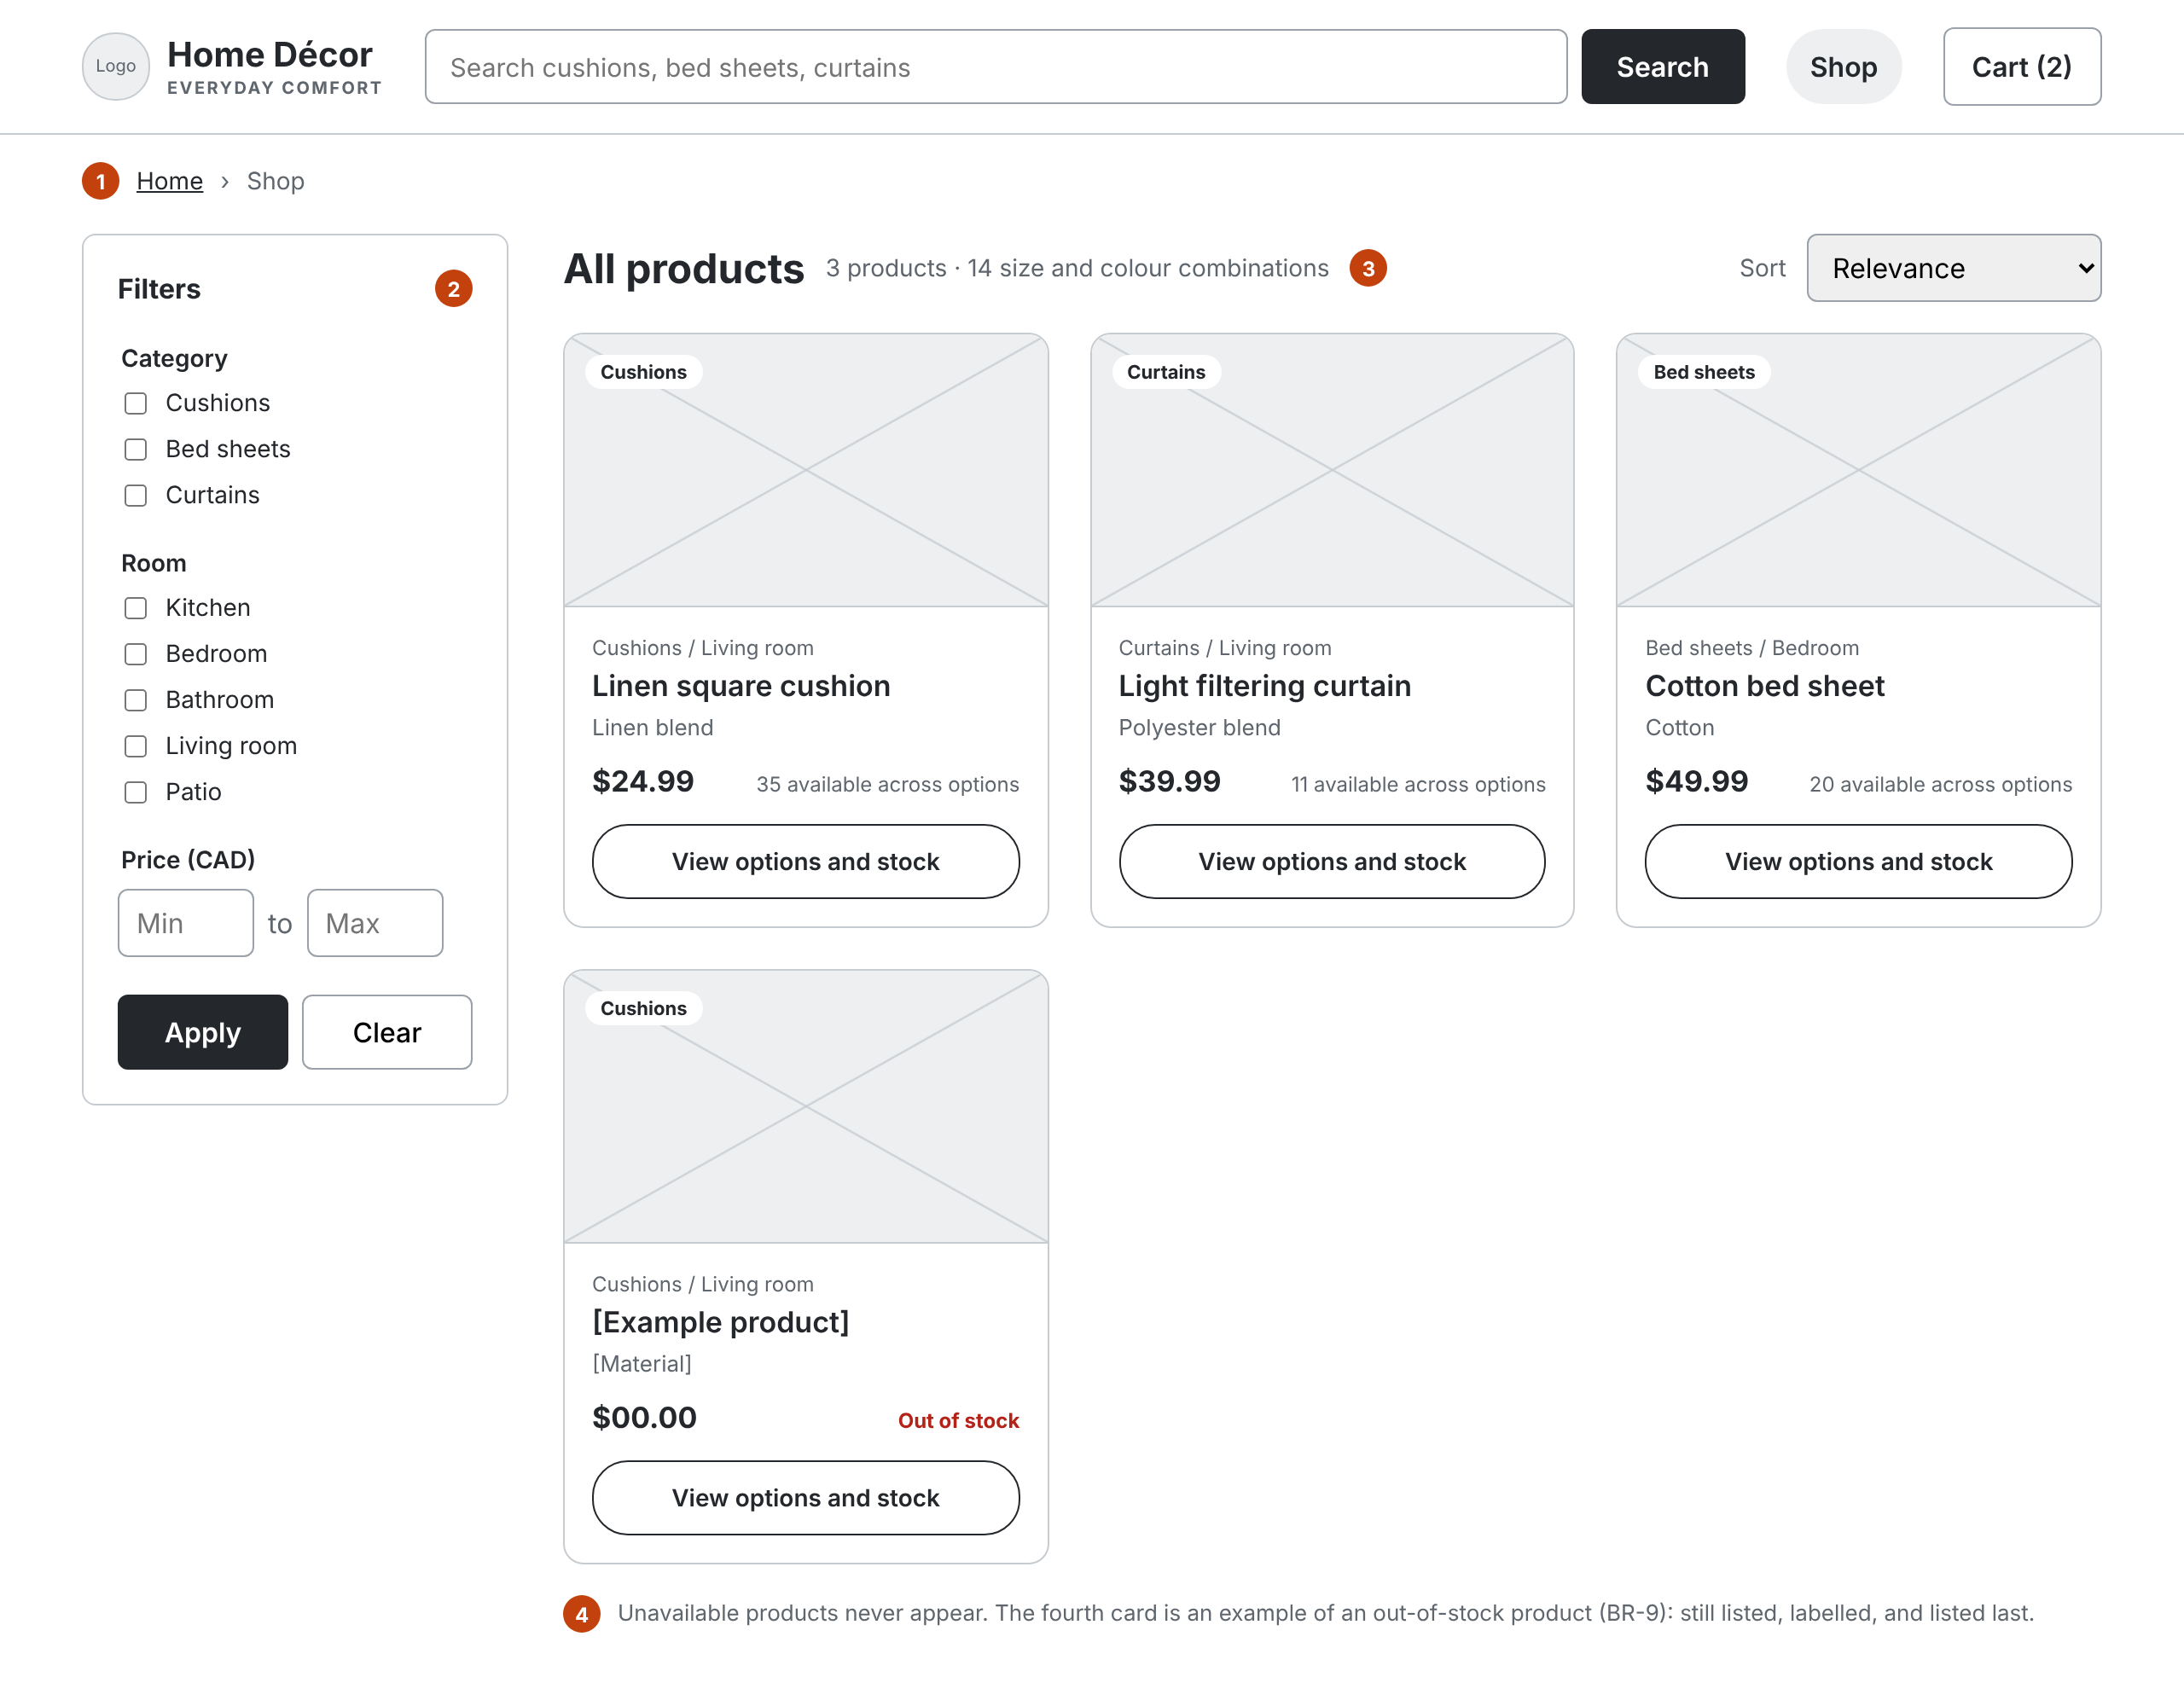
W-02 Search and category results
INCREMENT 2 · STOREFRONT
One card design on Home and in results.
1 Breadcrumb shows where the shopper is.
2 Filters: category, room, price in CAD.
3 Heading, product count and sort.
4 Unavailable products never appear. Out-of-stock ones are labelled and listed last.
Notes:
The fourth card is a made-up example to show the out-of-stock label; the live catalogue has three products. Card fields: category chip, placement, name, material, price, stock across options, and a View options and stock button.

Slide 5
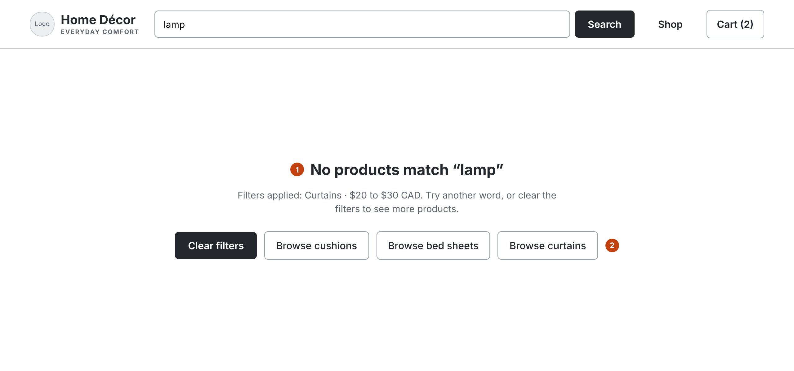
W-03 No results
INCREMENT 2 · STOREFRONT
An empty result explains itself and offers a way out.
1 Names the search term and the filters applied.
2 Clear filters, or browse a category.
Notes:
Covers CUS-05. The example searches for “lamp” with a Curtains filter and a $20 to $30 CAD price range.

Slide 6
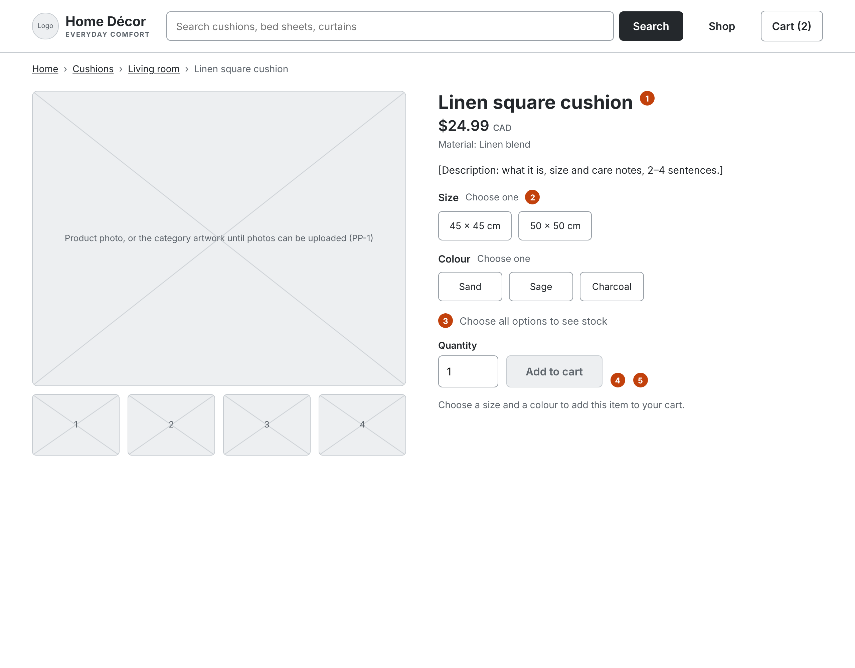
W-04 Product page
INCREMENT 2 · STOREFRONT
Add to cart unlocks only for a chosen size and colour that is in stock.
1 Photo, or the category artwork until upload exists. Price in CAD.
2 Size and Colour for Release 1 (D6).
3 Stock shows for the chosen combination.
4 Disabled until both options are chosen.
5 Quantity from 1 to the stock available.
Notes:
On the canvas this screen is interactive: choosing a size and a colour updates the stock line and enables Add to cart. Example: 45 × 45 cm in Charcoal has no stock, so the button stays disabled.

Slide 7
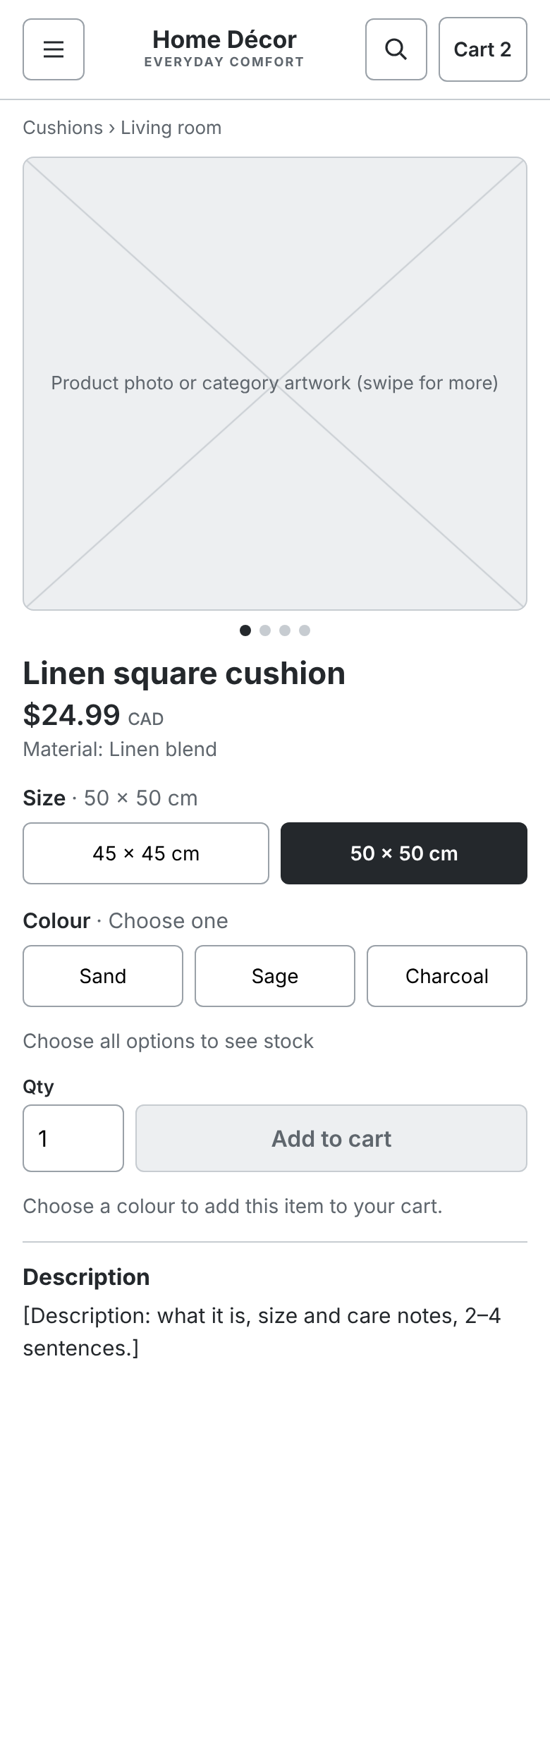
W-05 Product page, phone
INCREMENT 2 · STOREFRONT
The same content in one column, 390 px wide.
Size and colour buttons are 44 px touch targets.
Add to cart sits right after the options, so it is reached once they are chosen.
This covers the phone half of NFR-01; QA runs a phone check at the end of each increment.
Notes:
The photo area swipes through product photos, or shows the category artwork until photo upload exists.

Slide 8
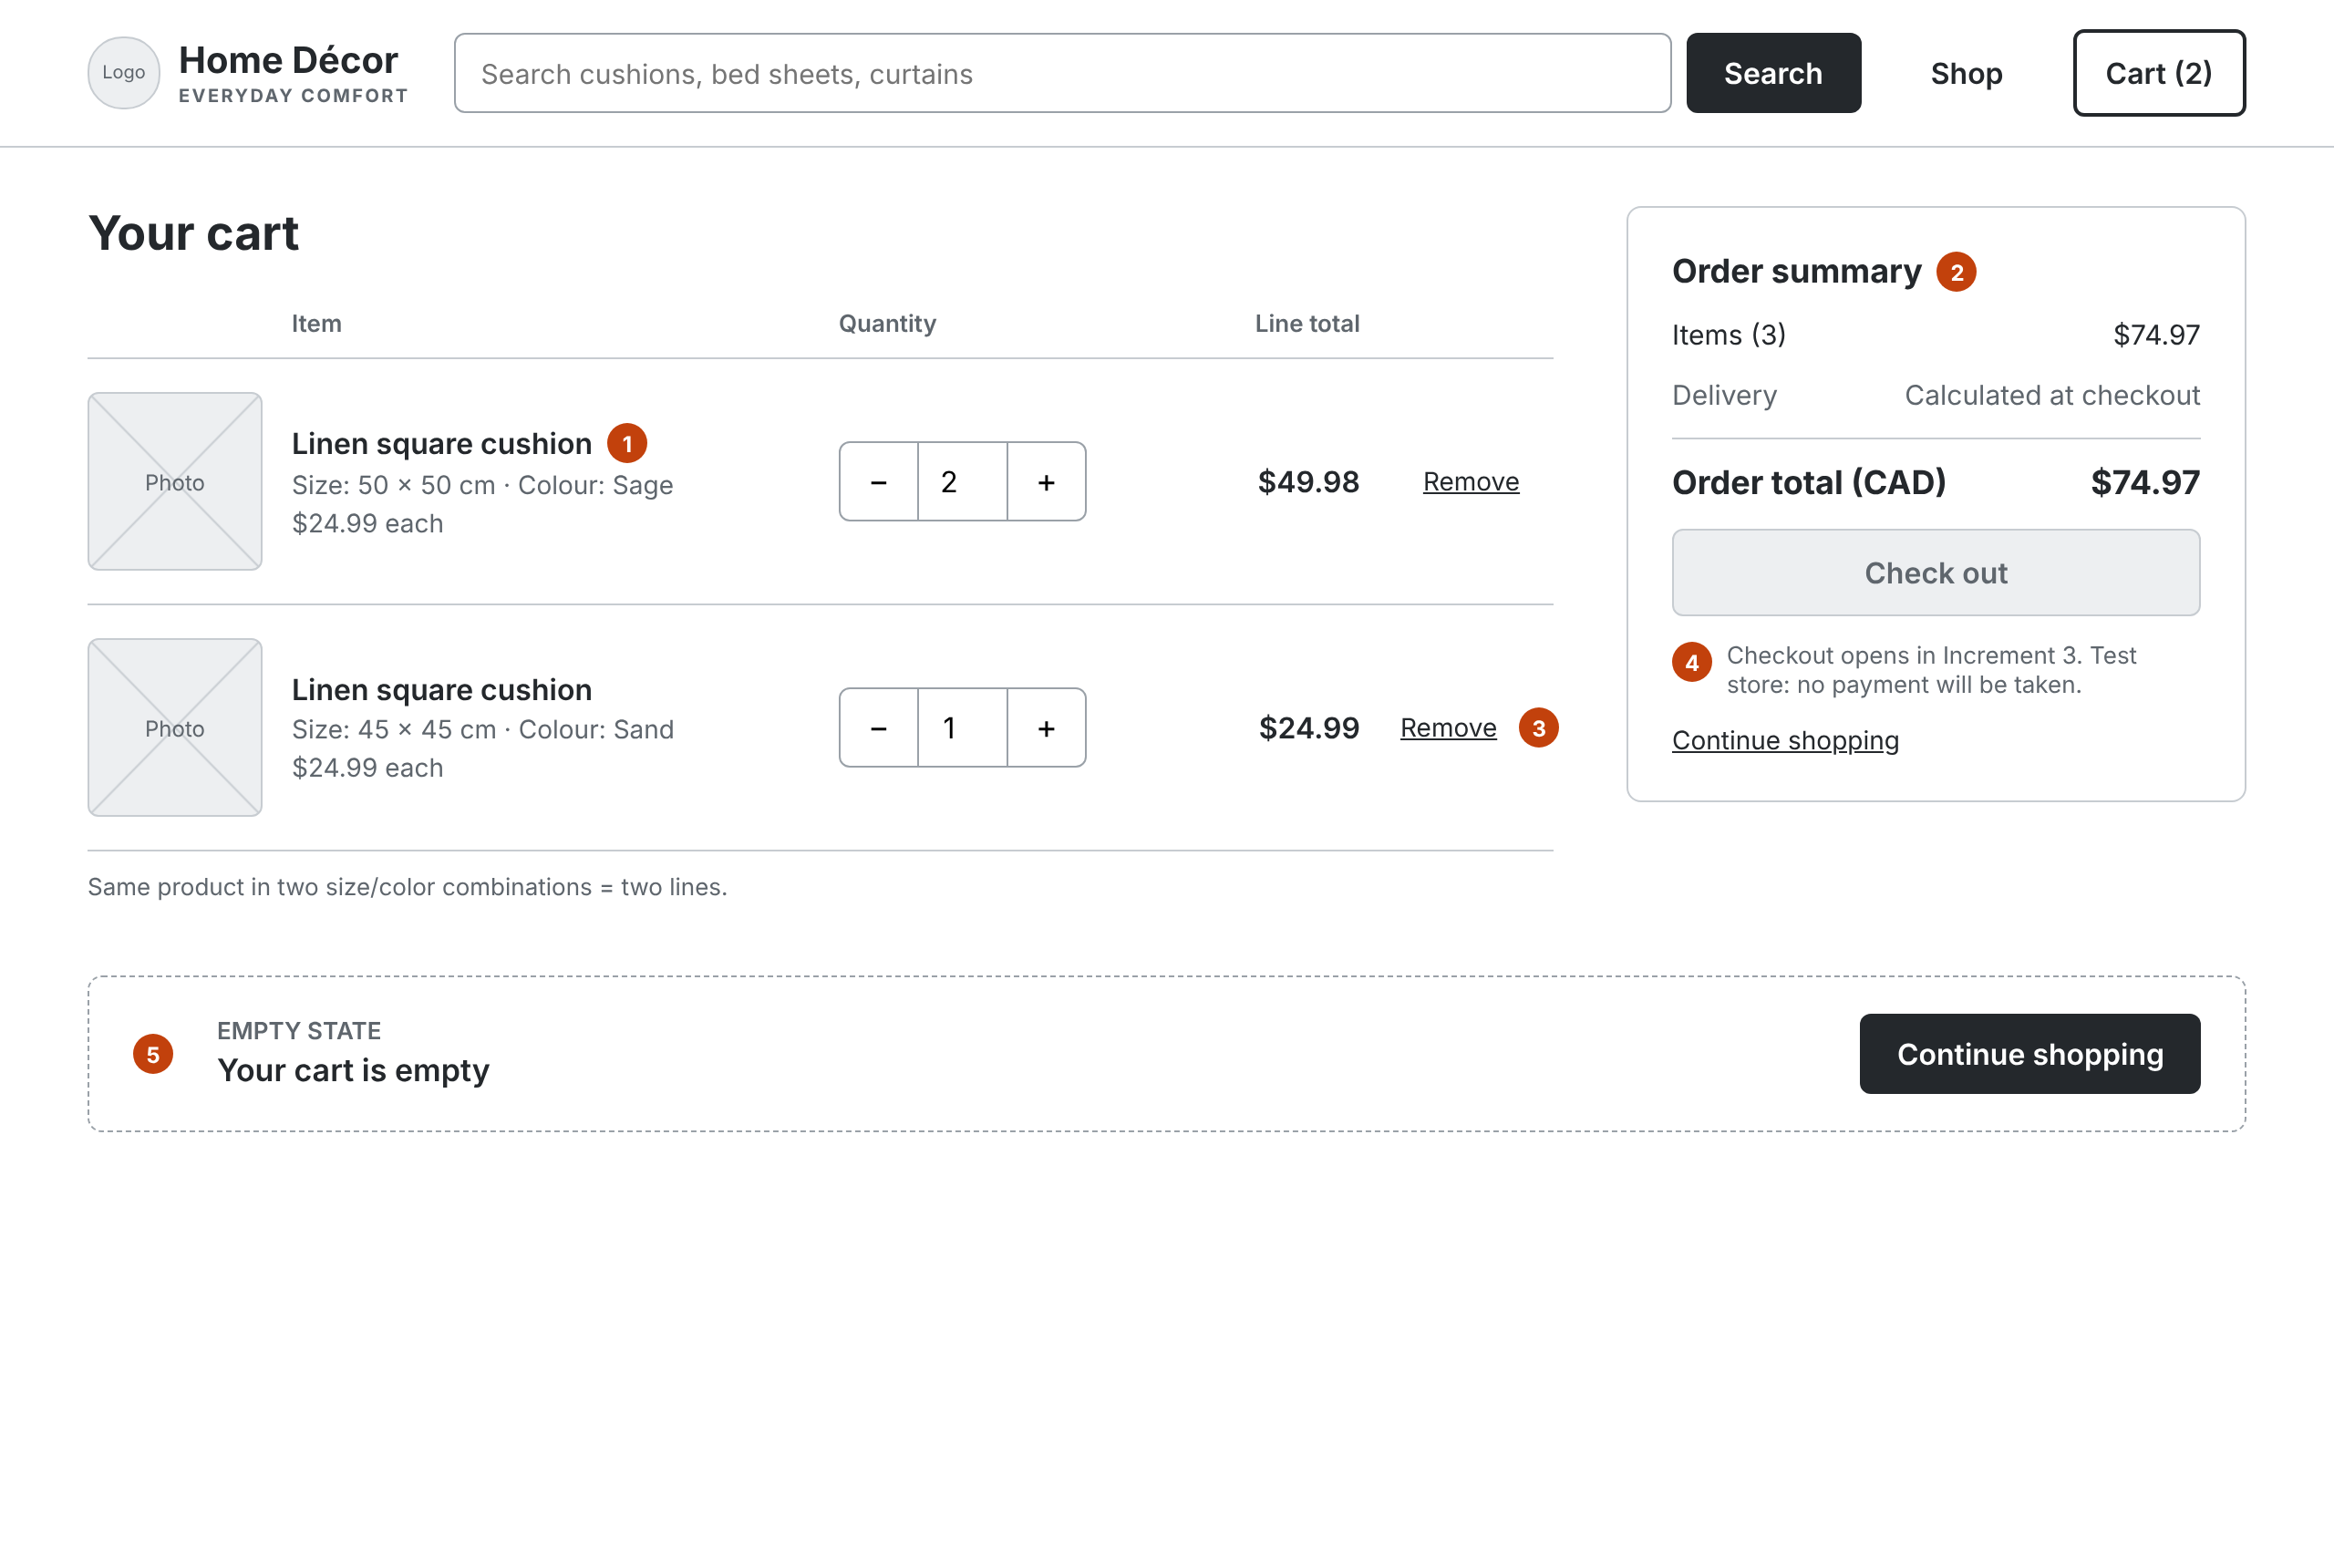
W-06 Cart
INCREMENT 2 · STOREFRONT
Totals update as soon as anything changes.
1 Each line shows size, colour and quantity.
2 3 × $24.99 = $74.97 CAD. Delivery: “Calculated at checkout”.
3 Stepper and Remove recalculate at once.
4 Check out stays disabled until Increment 3.
5 Empty state with Continue shopping.
Notes:
The example cart holds the Linen square cushion twice: 50 × 50 cm in Sage, quantity 2, $49.98; and 45 × 45 cm in Sand, quantity 1, $24.99. Order total $74.97 CAD. The cart stays in the browser until the shopper clears browser data (D2).

Slide 9
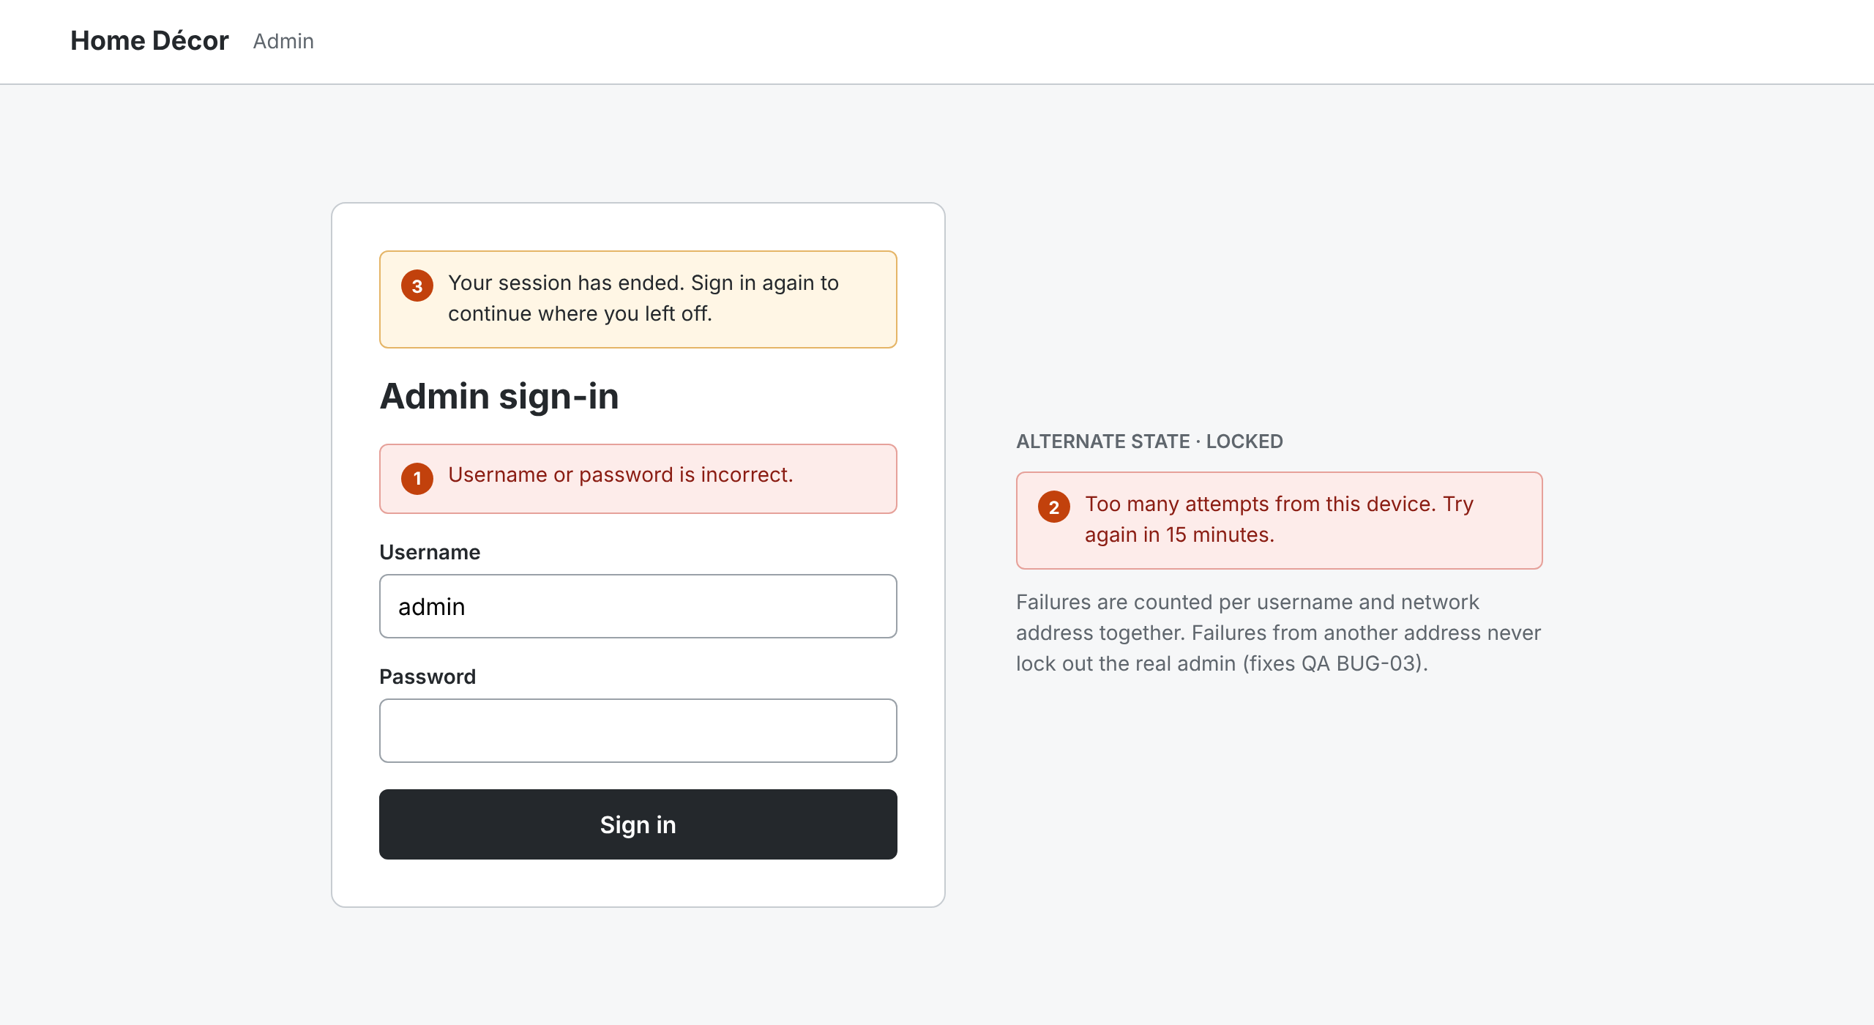
W-07 Admin sign-in
INCREMENT 1 · ADMIN
One message for any failed sign-in. Lockouts cannot block the real admin.
1 Same error for a wrong username or password.
2 Lockout counted per username and address (BUG-03 fix).
3 “Your session has ended” banner after expiry.
Notes:
QA found the week 2 lockout counter was global: five failures from anyone blocked the real admin. The fix counts failures per username and network address together.

Slide 10
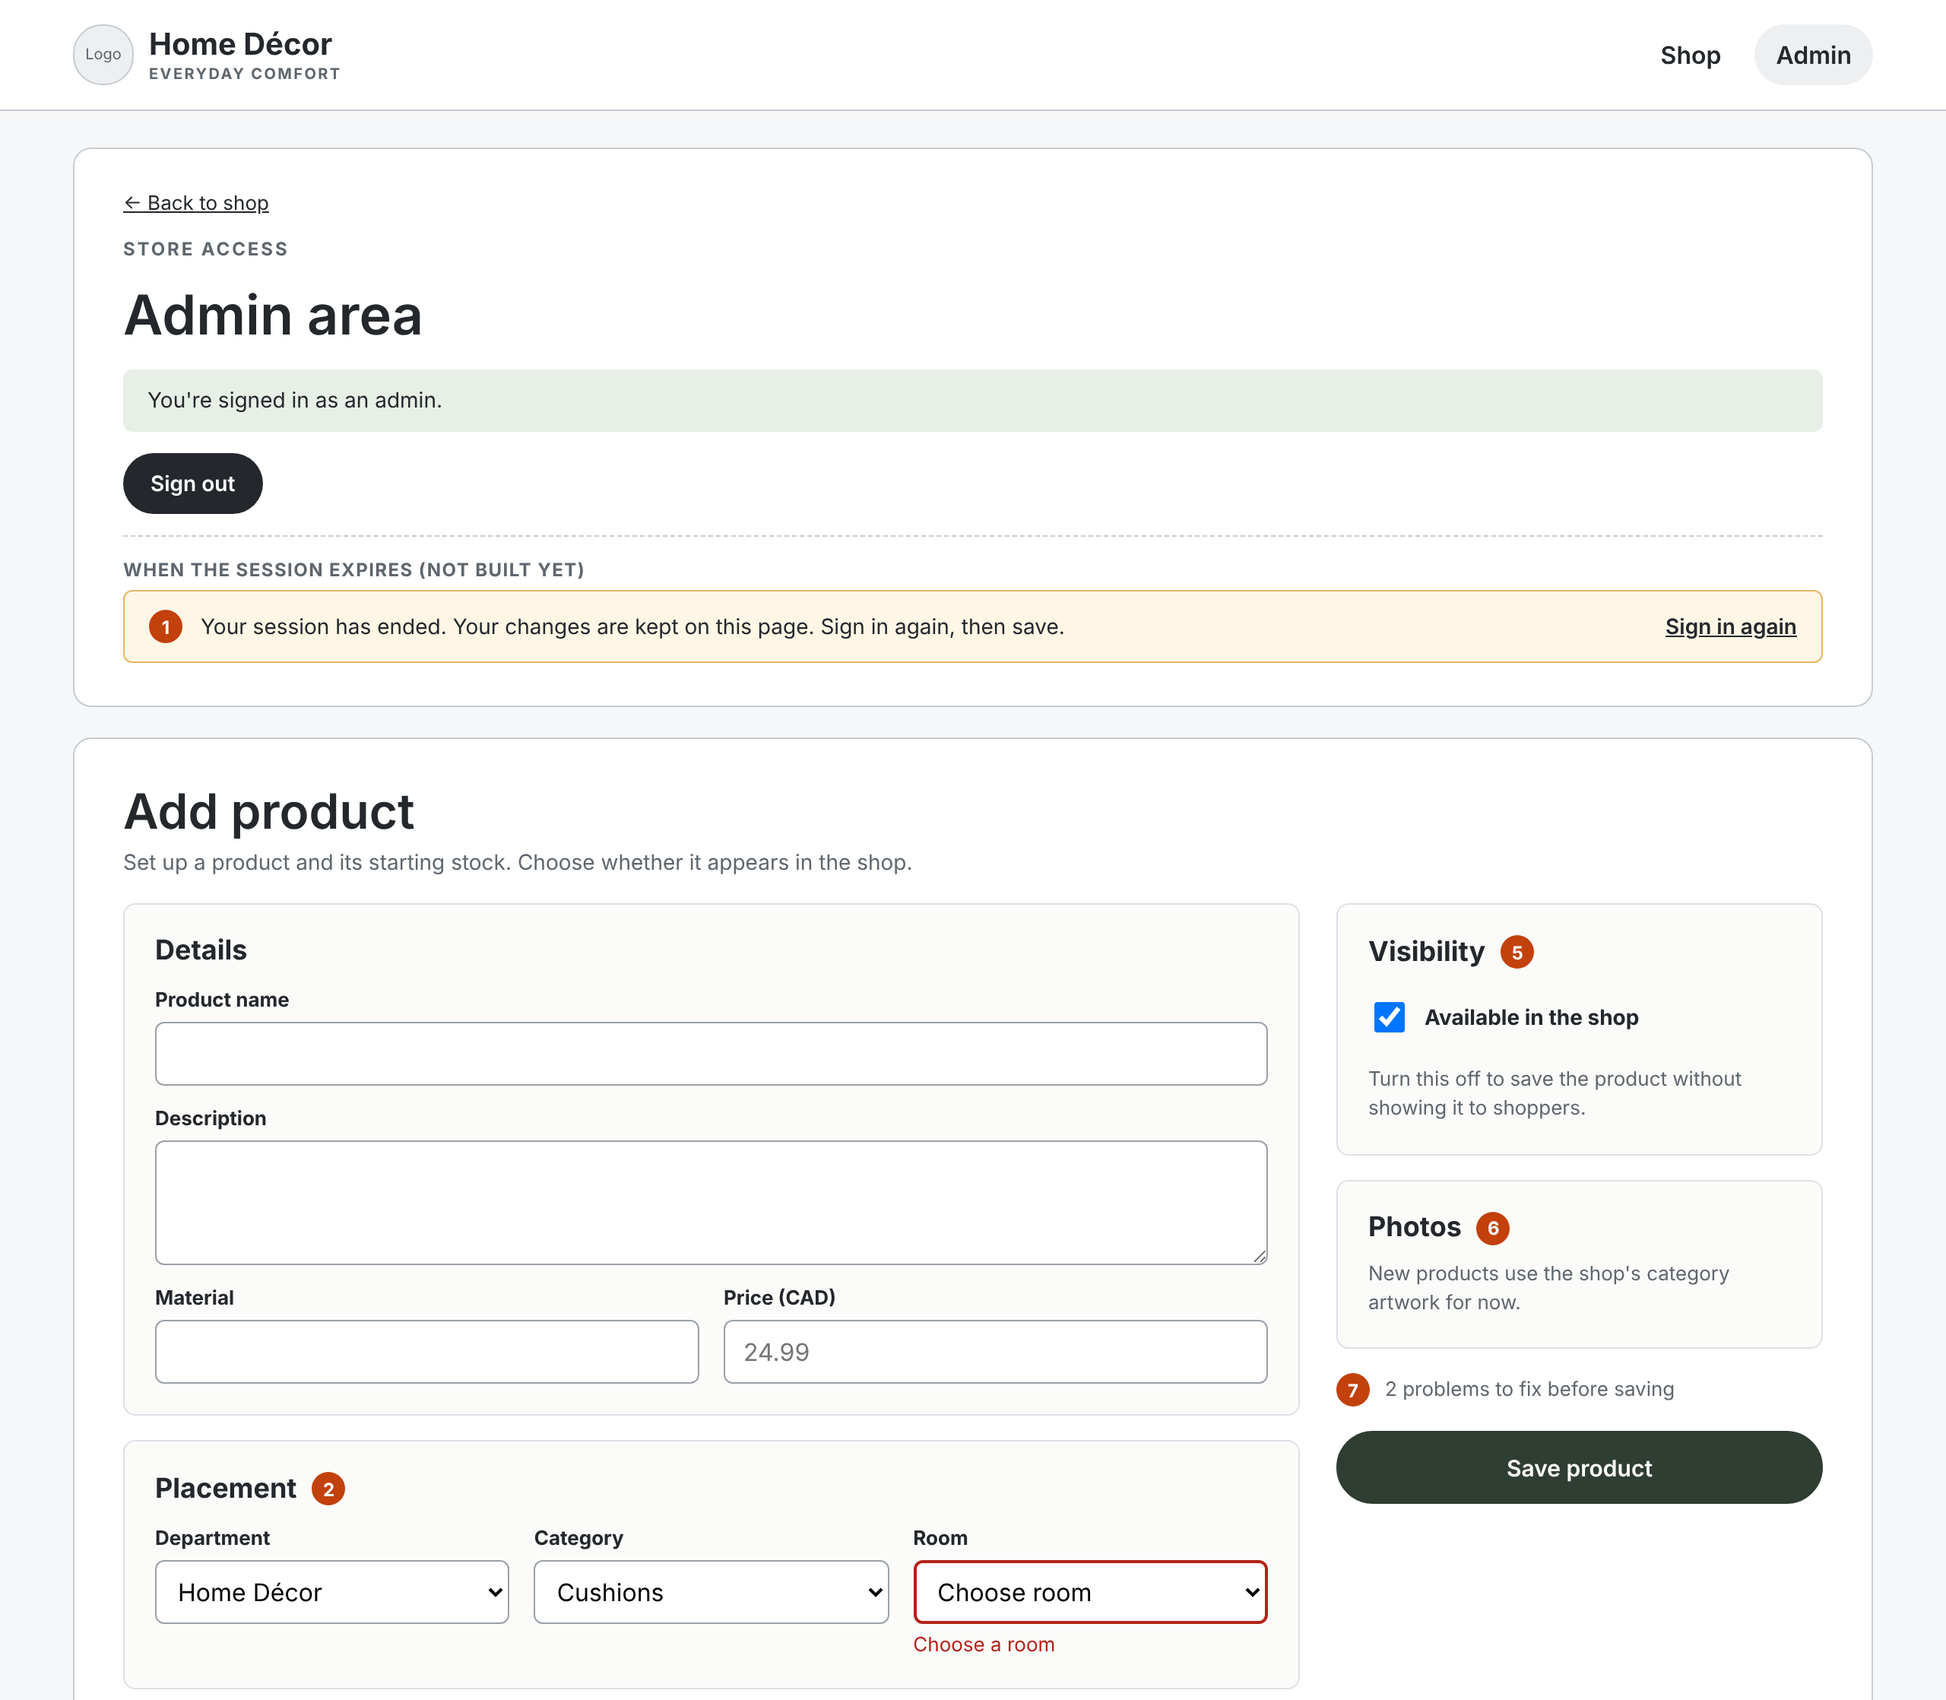
W-08 Admin area: add product (1 of 2)
INCREMENT 1 · ADMIN
Matches the live Add product page.
1 Session-expired banner that keeps the admin’s input. Not built yet (OBS-09).
2 Placement: Department, Category, Room. Each list shows only the children of the one before.
5 Available in the shop: off hides the product from shoppers.
6 No photo upload yet; new products use the category artwork.
7 Save checks everything on the server and shows each error beside its field.
Notes:
Markers 3 and 4, Options and Stock by combination, are on the next slide.

Slide 11
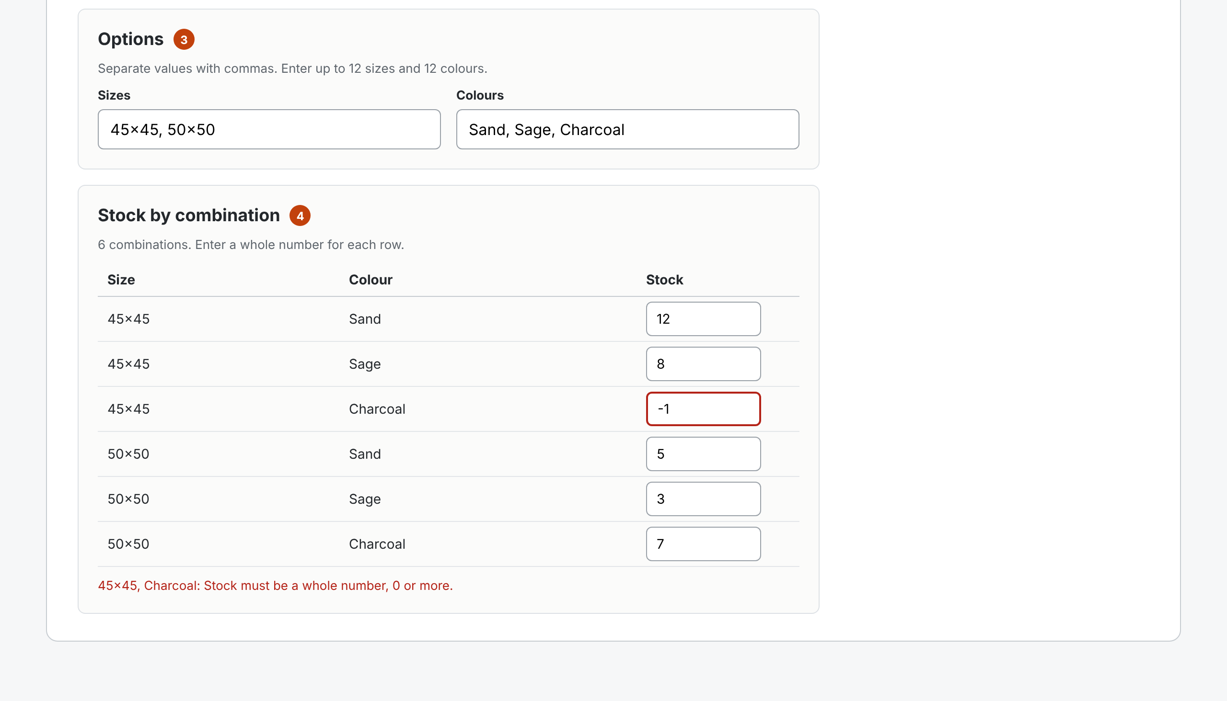
W-08 Admin area: add product (2 of 2)
INCREMENT 1 · ADMIN
Stock is entered for every size and colour pair.
3 Sizes and Colours as comma-separated lists, up to 12 each (D6, as built).
4 One row per pair, built by the system. Whole numbers, 0 or more (BUG-01).
Notes:
Two sizes and three colours make six rows. The example shows −1 entered for 45×45 Charcoal and the message that appears under the grid.

Slide 12
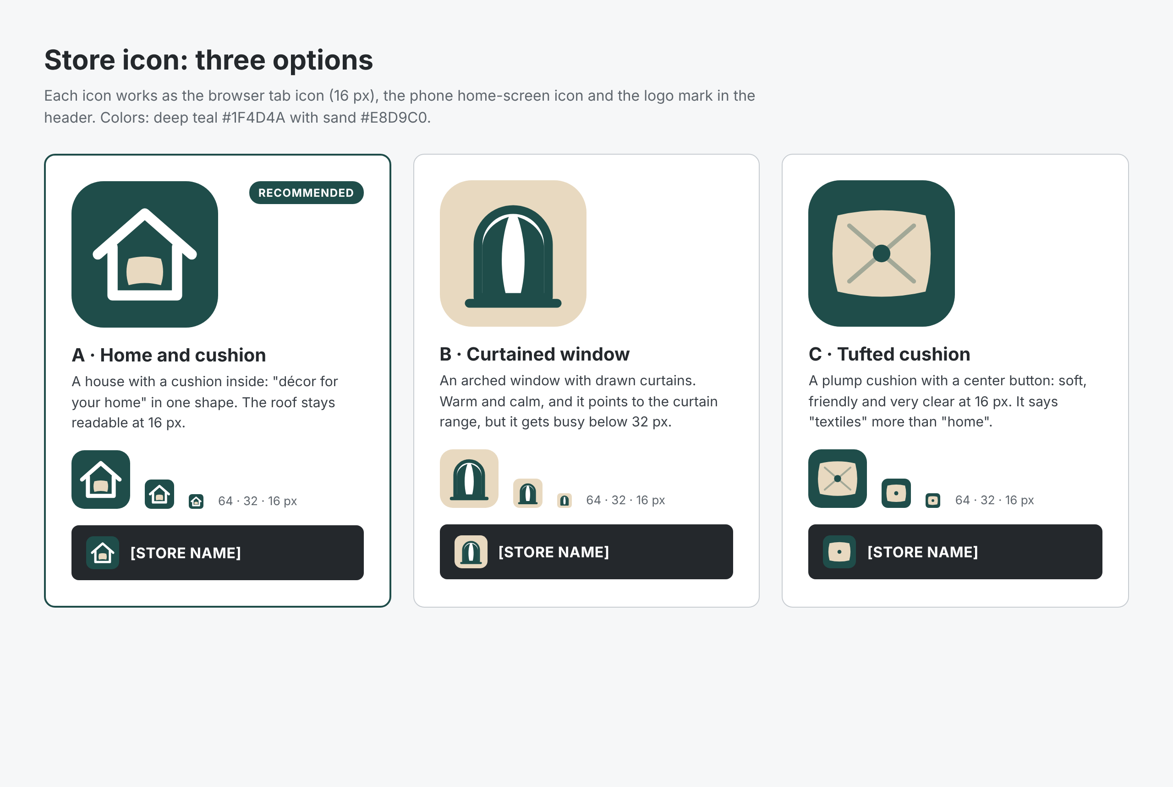
Store icon: three options
BRAND
Option A, a house with a cushion, is recommended.
A · Says “décor for your home” in one shape; the roof still reads at 16 px.
B · Curtained window: warm, but busy below 32 px.
C · Tufted cushion: clearest at 16 px, says textiles more than home.
Notes:
All three use deep teal and sand. The live site currently uses a different star-shaped mark in its header, so choosing an icon also means replacing that mark.

Slide 13
Four gaps between the wireframes and the live site
STILL OPEN
Admin link in the shop header
Session-expired banner
Visible to every shopper today. Remove it (OBS-07).
The admin page doesn’t notice an expired session yet (OBS-09).
Photo upload
Storefront features
Products use the category artwork until upload is built.
Search, categories, rooms, product page and cart: Increment 2, weeks 4–5.
Notes:
Each gap is also listed in the notes beside the matching screen on the wireframe canvas.

